Slide 1
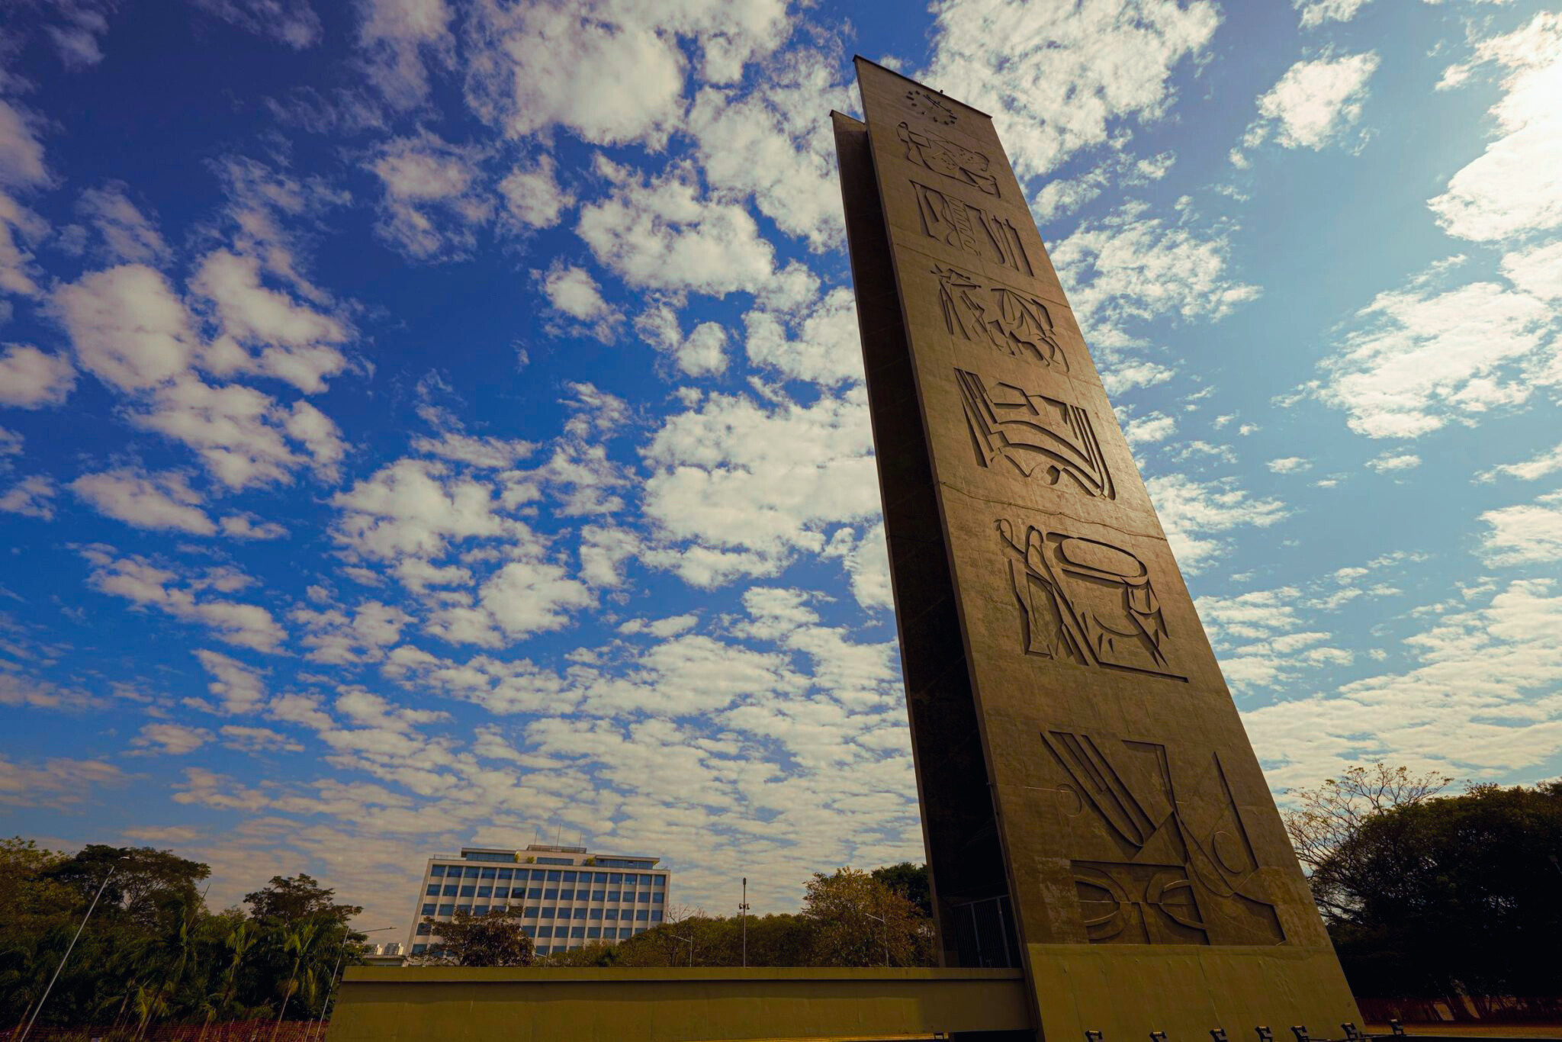

\
UNIVERSITY OF
SÃO PAULO
2026
Notes:
1.7.2013
‹#›

Slide 2
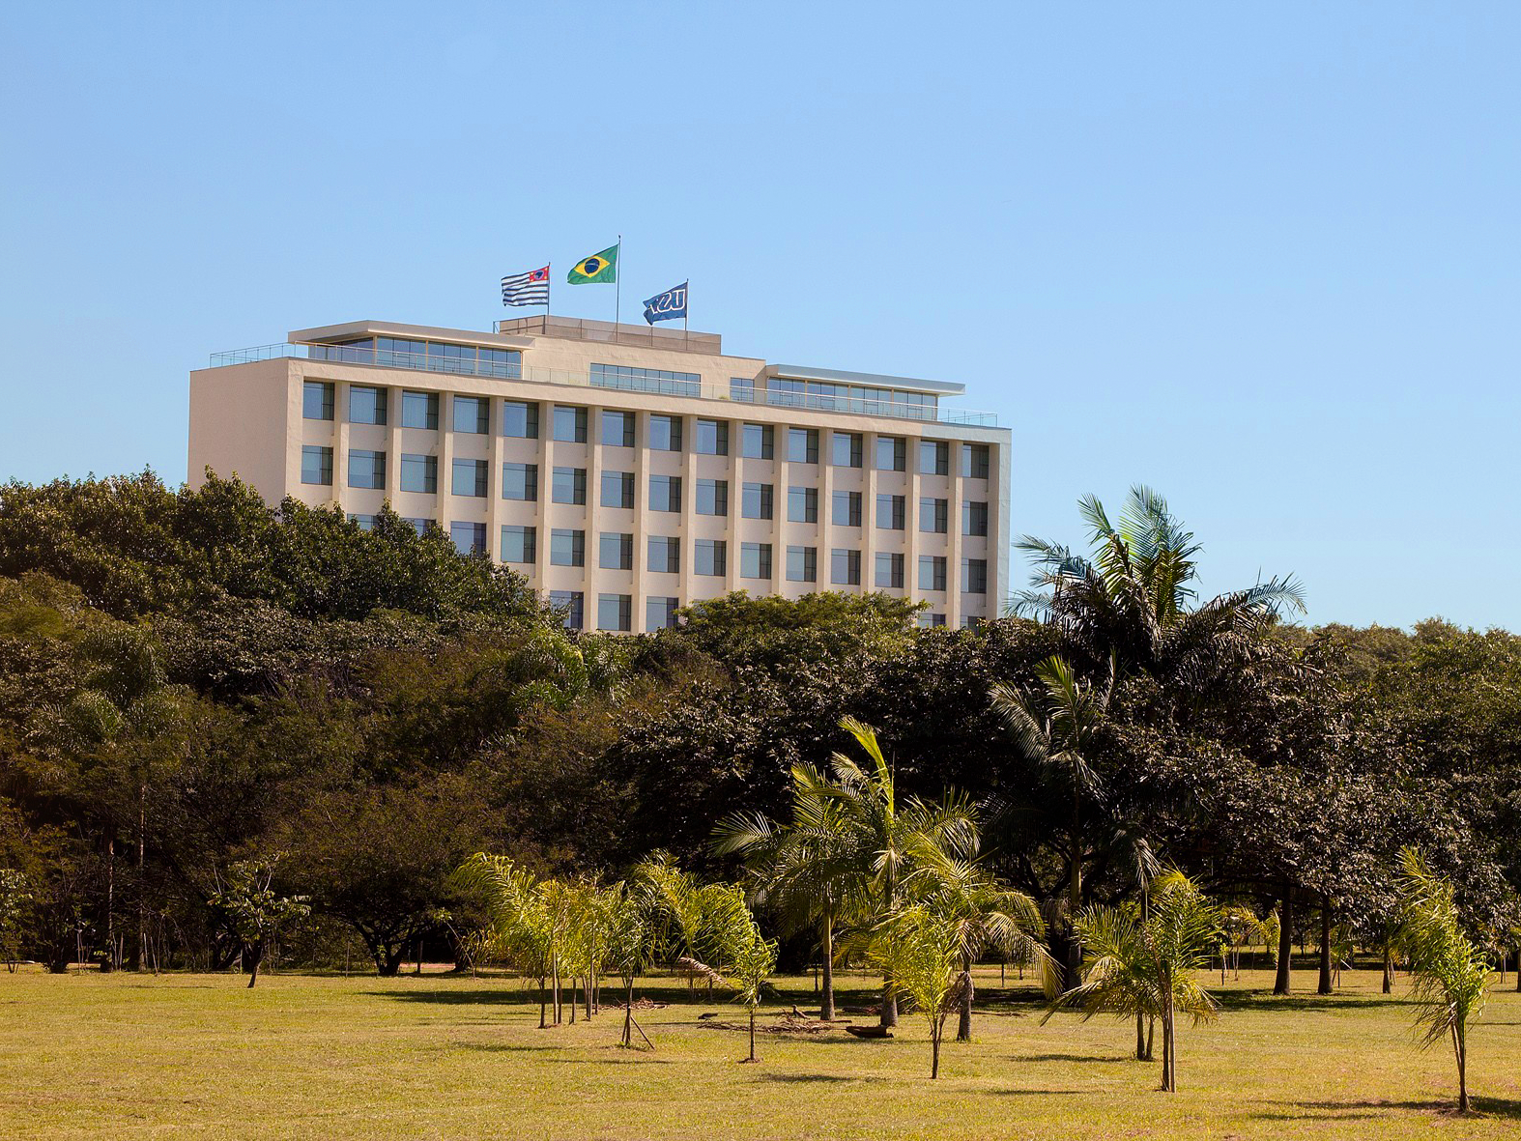


ABOUT USP
Established in 1934, USP is a leading public university in Brazil, dedicated to Excellence in Education, Research, Outreach and Innovation.
‹#›
Notes:
1.7.2013
‹#›

Slide 3
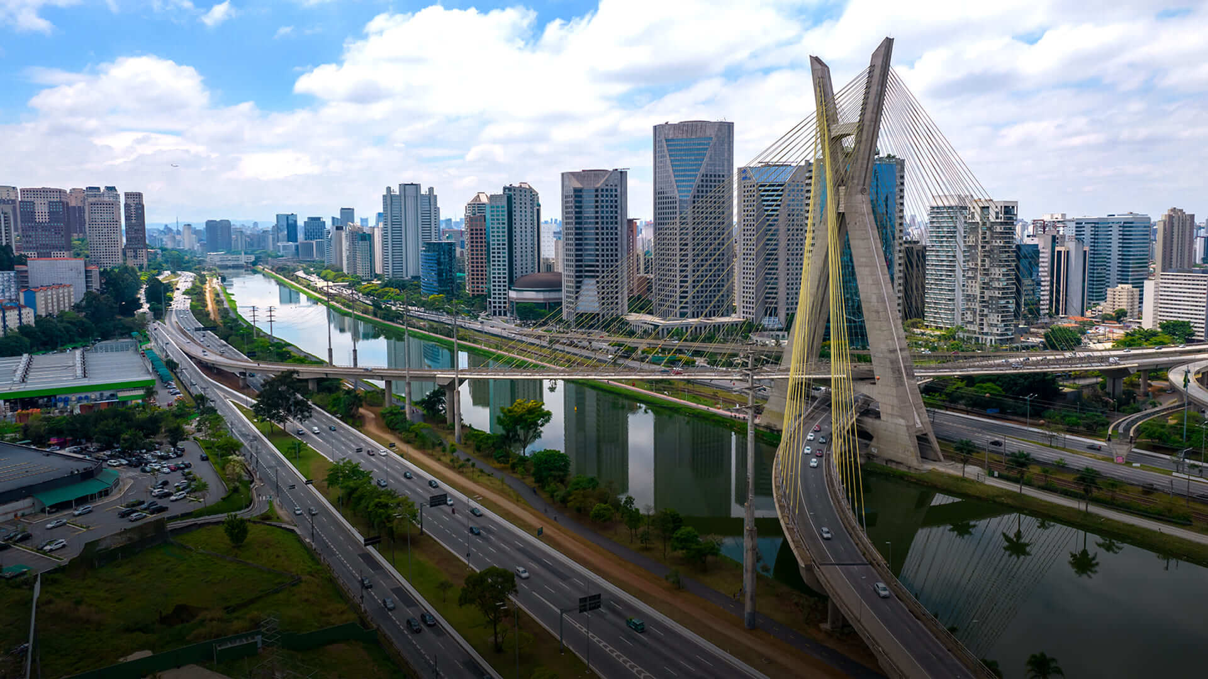
SÃO PAULO STATE ECOSYSTEM
32% Brazil’s GDP
22% Brazil’s Population
Brazil’s leading innovation hub
Home to USP, UNICAMP, and UNESP
Notes:
1.7.2013
‹#›

Slide 4
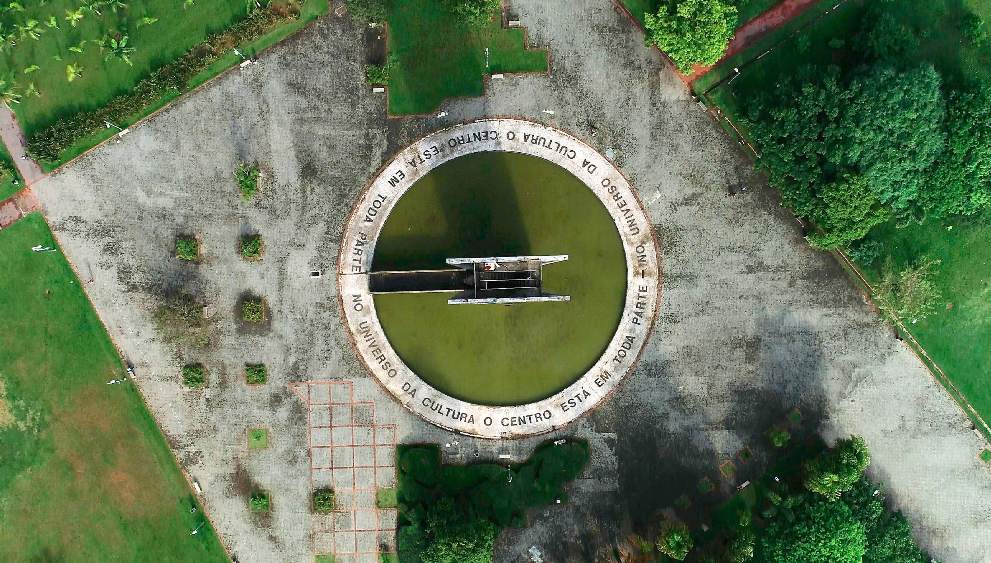
USP AT A GLANCE
97,561
STUDENTS
43 UNITS
6,000+
FACULTY
5 INSTITUTES
4
AFFILIATED
HOSPITALS
89%
FULL-TIME
FACULTY
325 (Undergraduate)
260 (Graduate)
PROGRAMS
Notes:
1.7.2013
‹#›

Slide 5
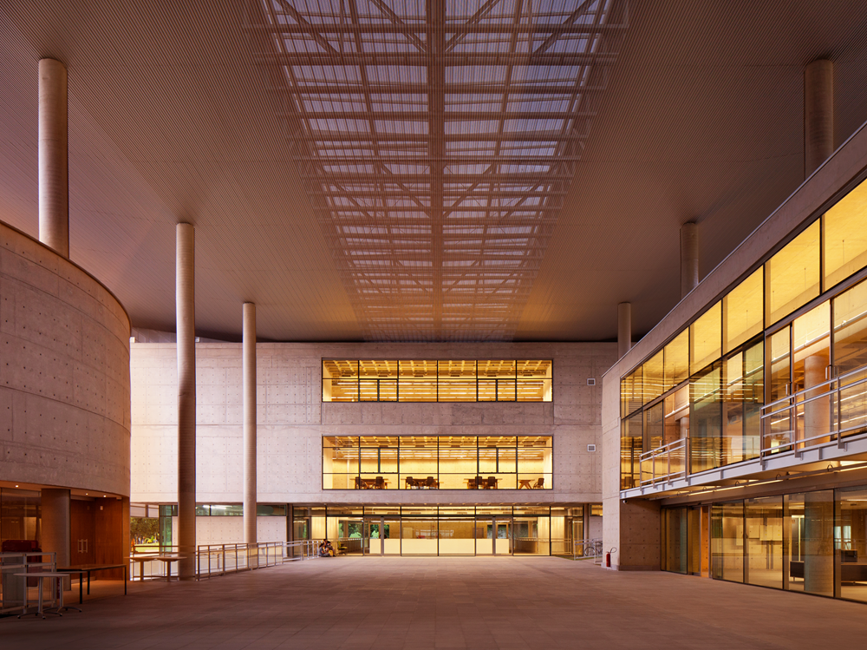
WHAT DEFINES USP
COMPREHENSIVE
RESEARCH LEADER
TEACHING LEADER
TUITION-FREE
AUTONOMOUS
MULTI-CAMPUS
Notes:
1.7.2013
‹#›

Slide 6
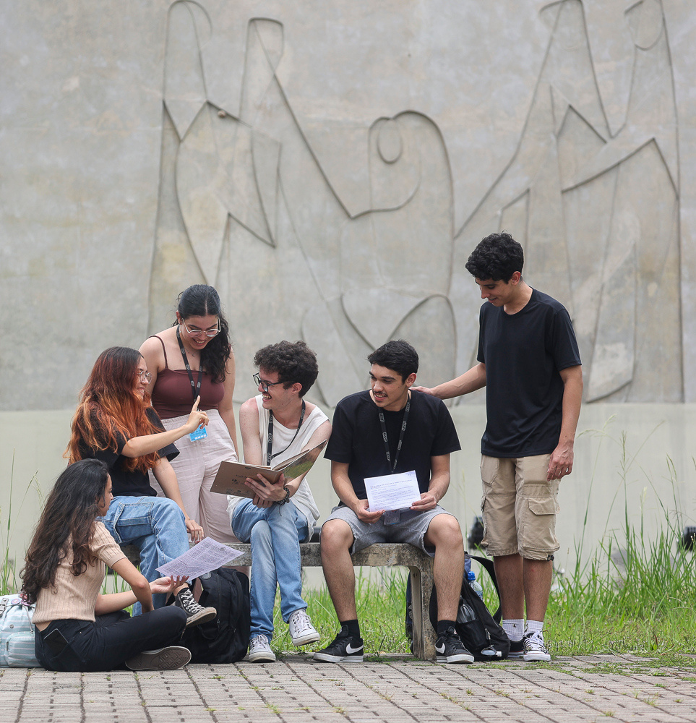
EDUCATION & TALENT
APPLICATIONS SELECTION USP STUDENTS
100K+
APPLICANTSPER YEAR
HIGHLY
COMPETITIVE
ADMISSIONS
STRONG
GRADUATE
SYSTEM
Notes:
1.7.2013
‹#›

Slide 7
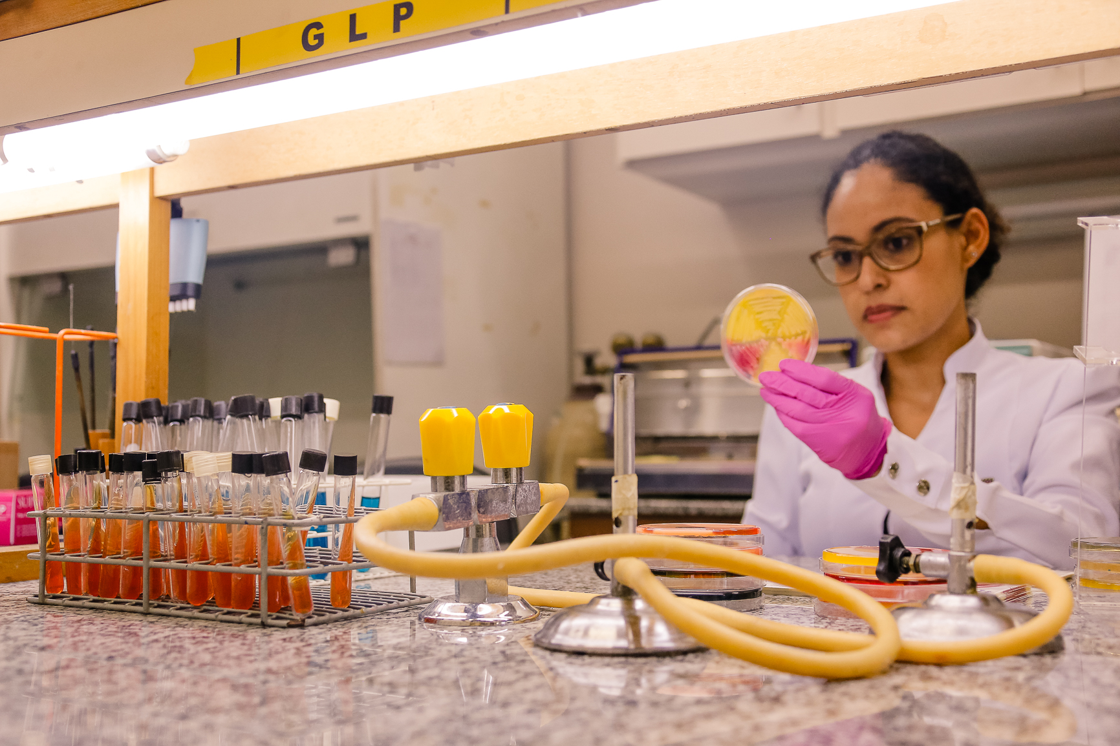
EXCELLENCE RESEARCH
18% OF BRAZIL’S
SCIENTIFIC OUTPUT
17,000+
PUBLICATIONS PER YEAR
STRONG
INTERNATIONAL
COLLABORATION
HIGH GLOBAL
CITATION
IMPACT
Notes:
1.7.2013
‹#›

Slide 8
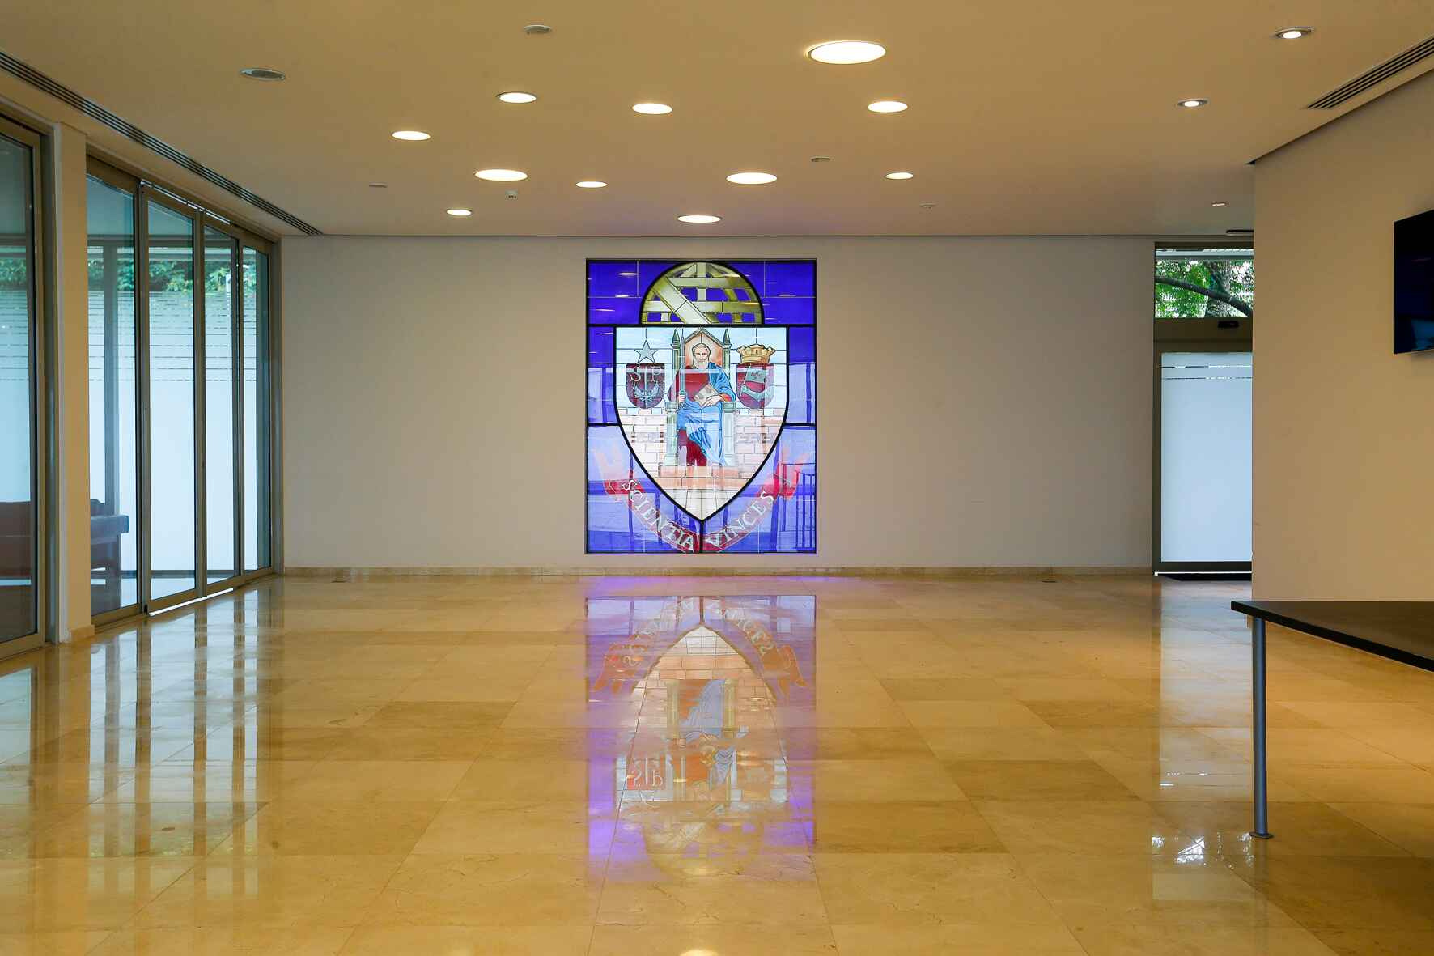

International Recognition
BY SUBJECTS - TOP 50 IN SOME MAJOR AREAS:
12th
15th
24th
25th
28th
29th
Art History
Dentistry
Engineering -
Mineral & Mining
Anthropology
Library & Info Management
Engineering -
Petroleum
108th in the World
2026 edition
32nd
43rd
43rd
48th
50th
Agriculture &
Forestry
Pharmacy & Pharmacology
Architecture &
Built Environment
Sociology
Medicine
‹#›

Slide 9
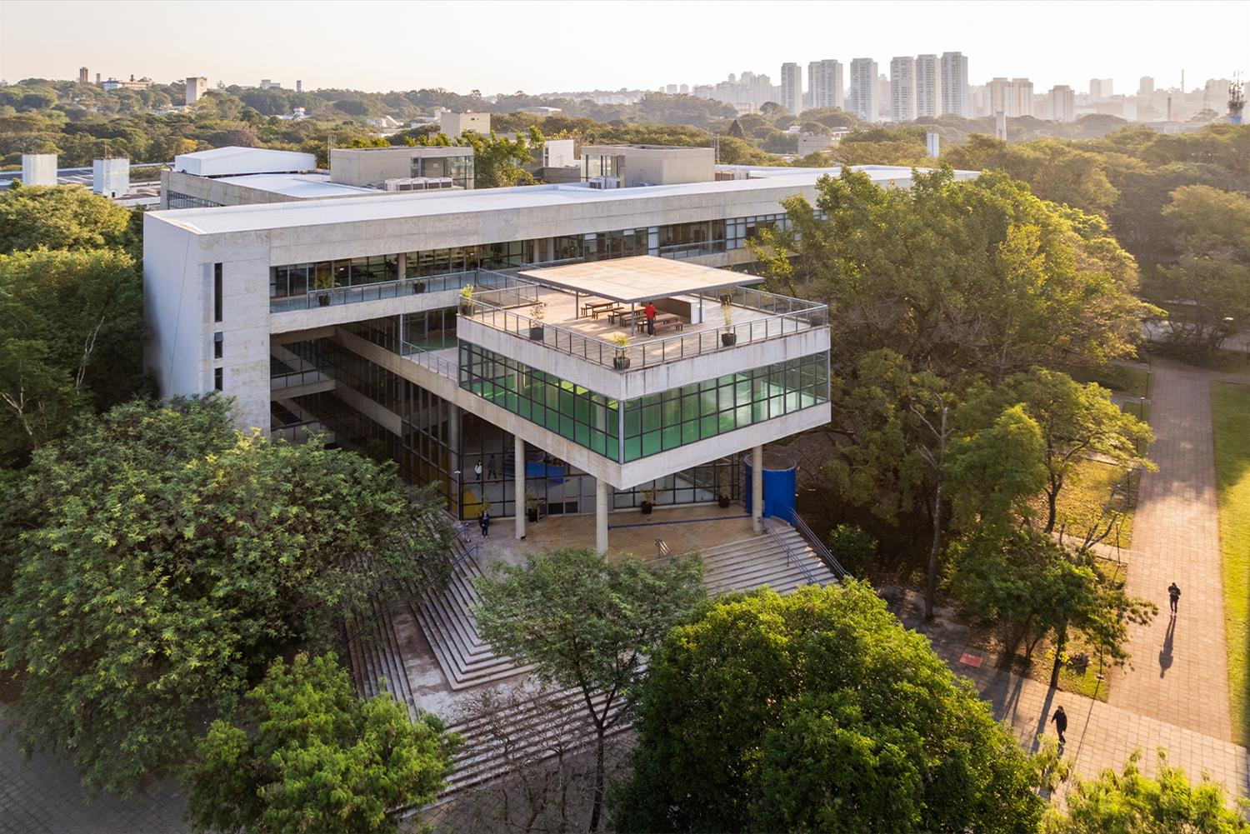
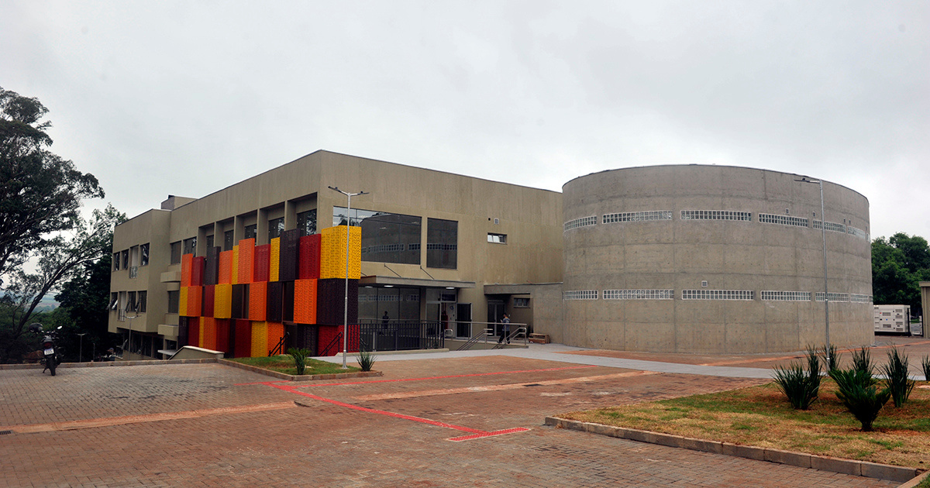
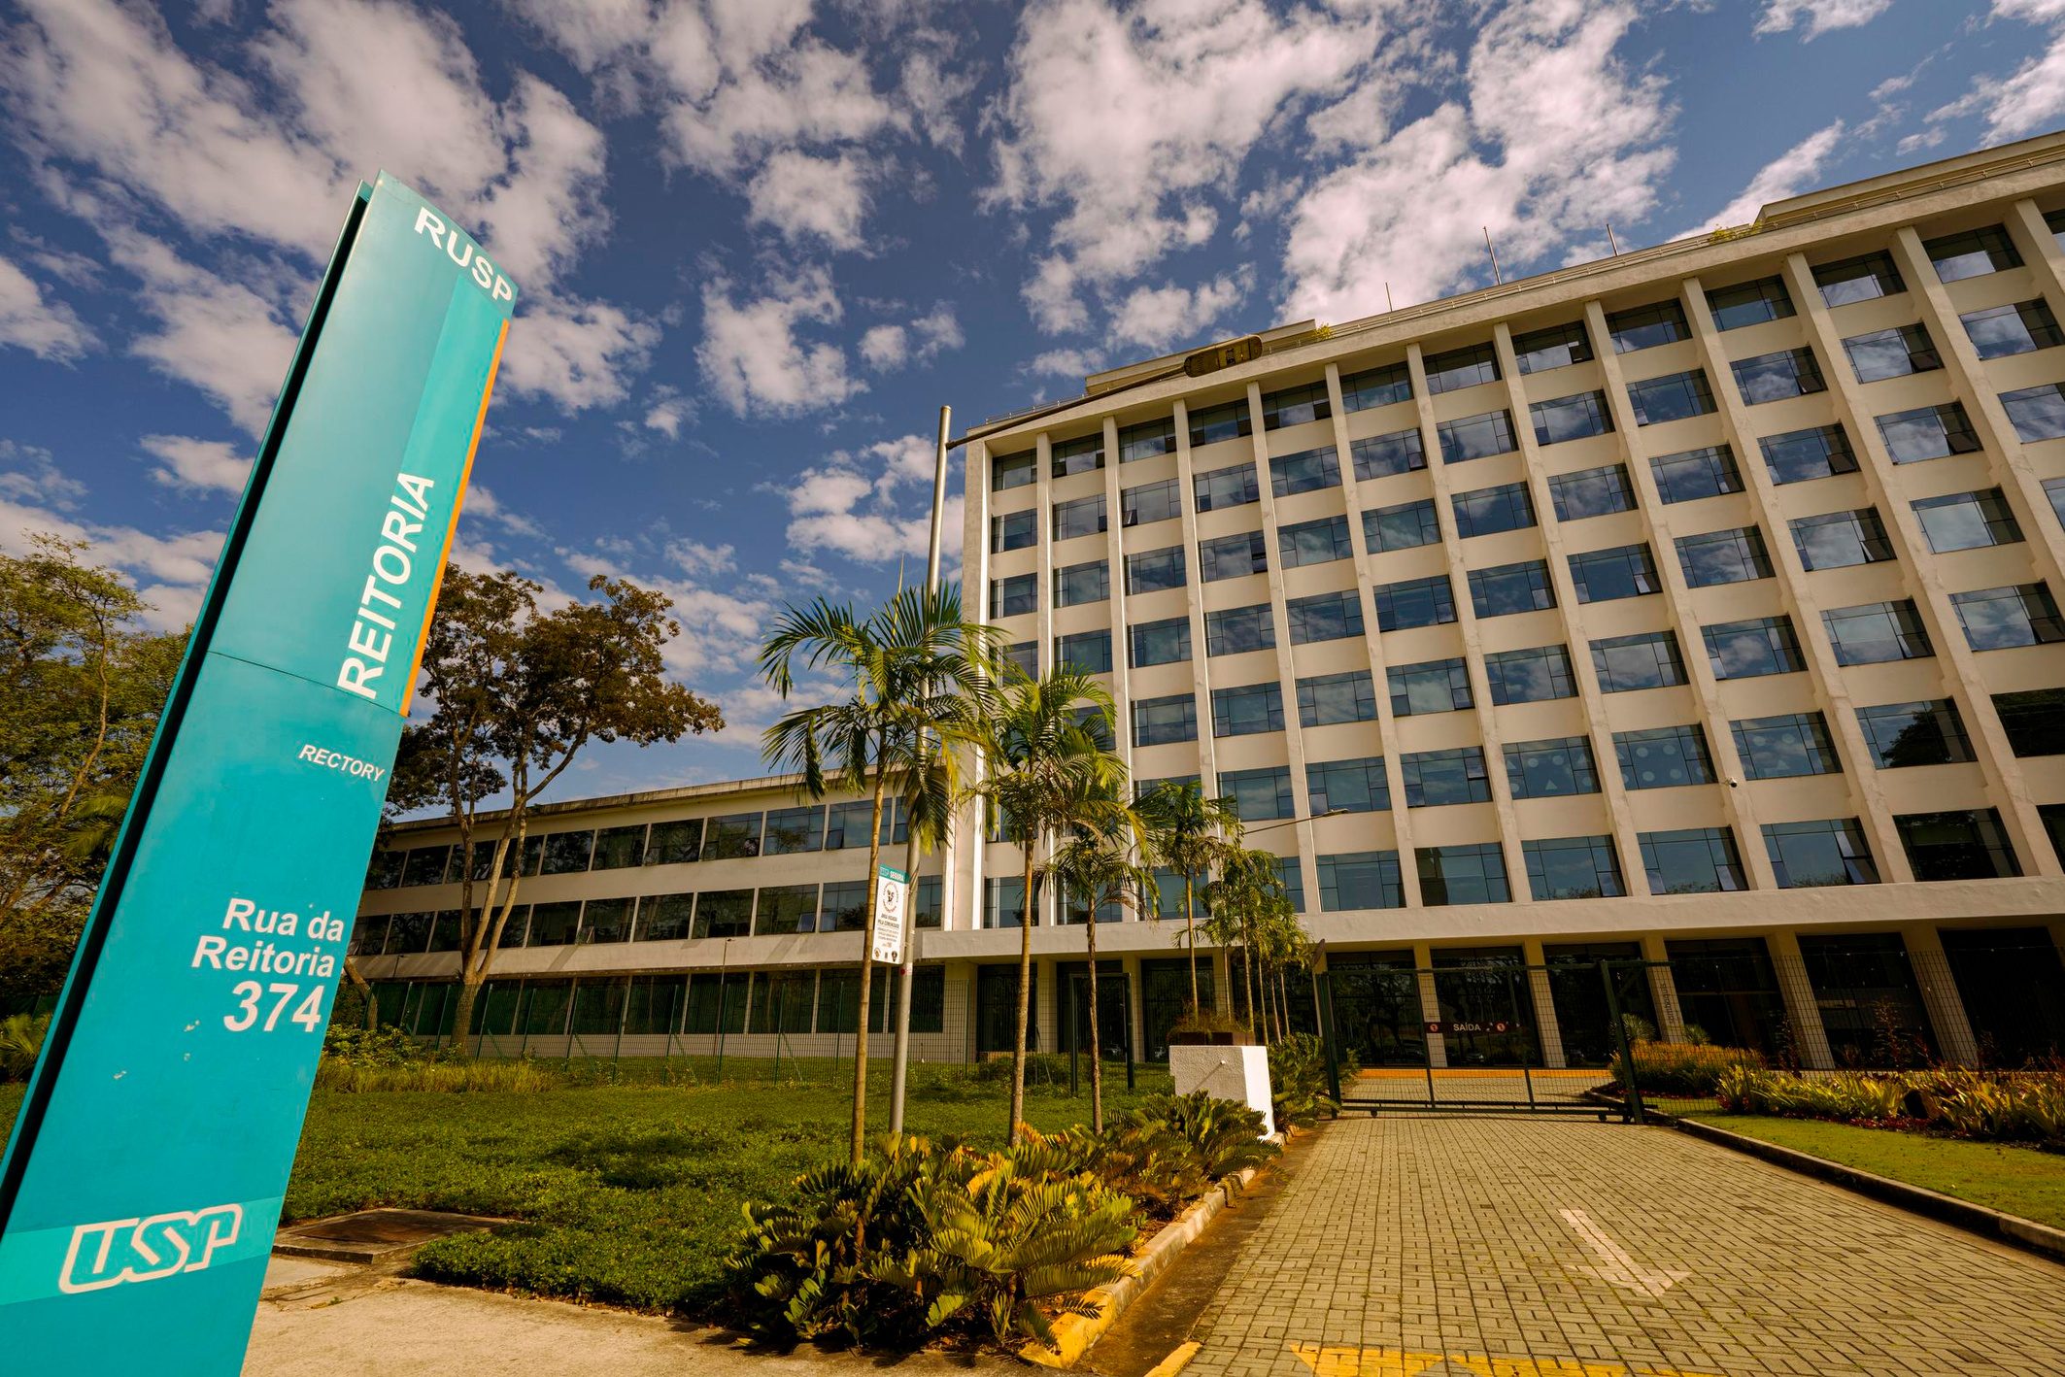
INNOVATION & PARTNERSHIPS
START-UPS
TECH TRANSFER
ENTREPRENEURSHIP
INCUBATORS
RESEARCH CENTERS
INDUSTRY
PARTNERSHIPS
Notes:
1.7.2013
‹#›

Slide 10
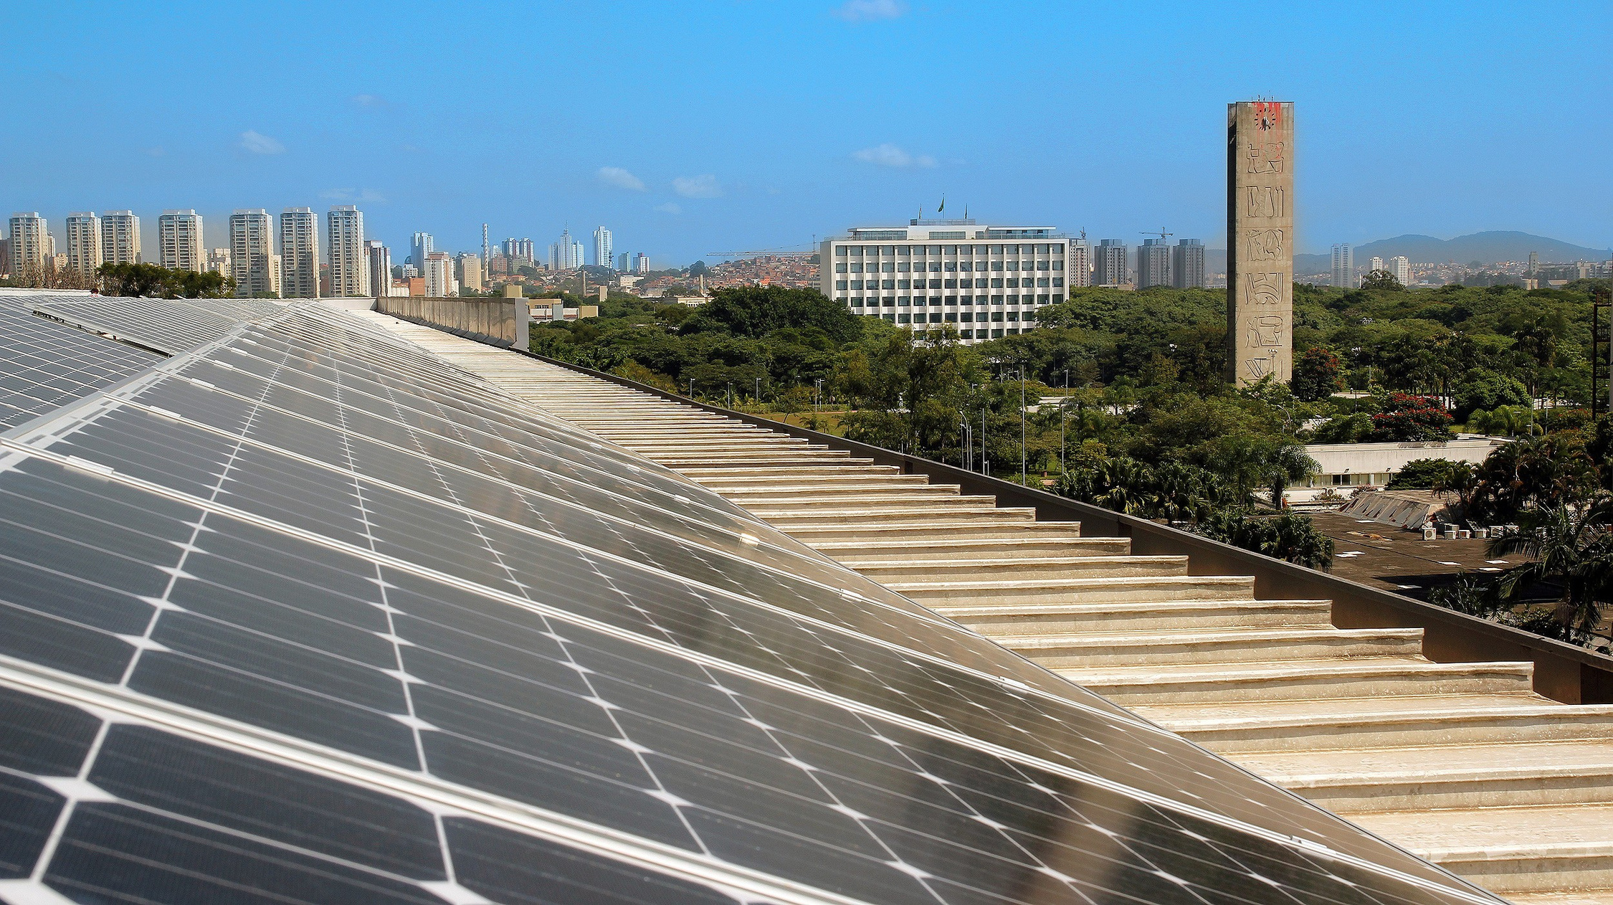
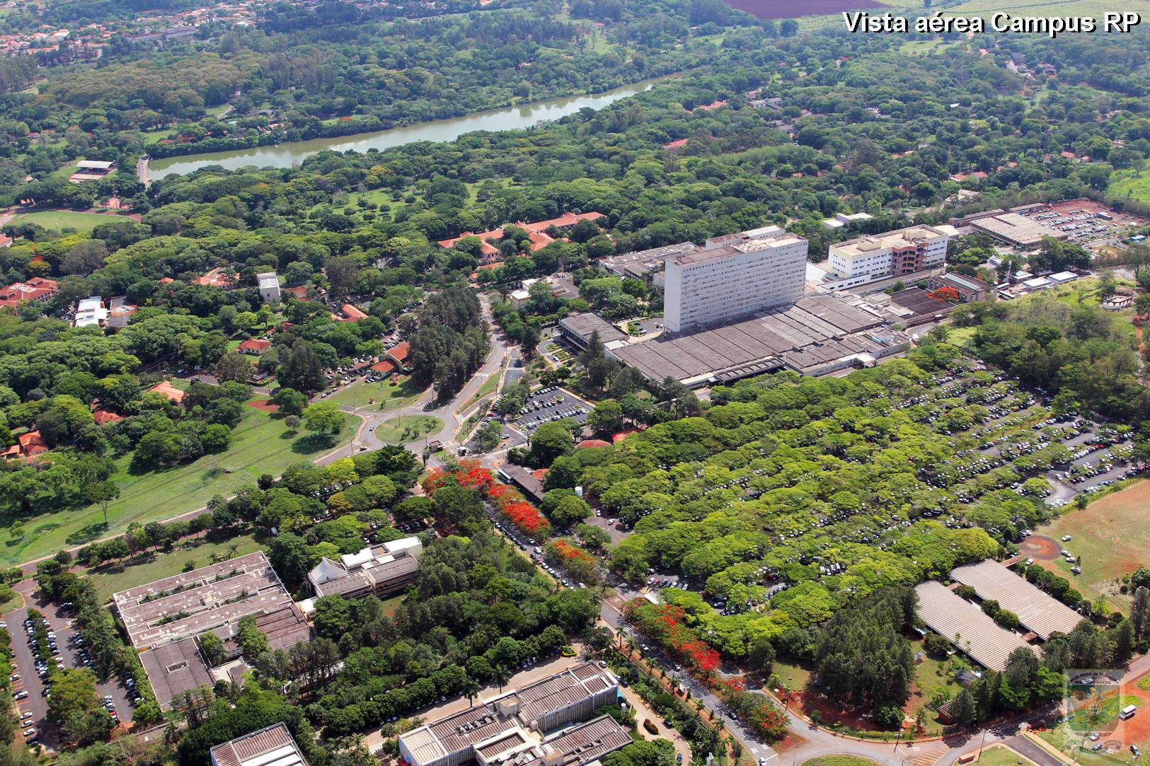

SUSTAINABILITY & IMPACT
RENEWABLE
ENERGY
2,200+ HECTARES
ECOLOGICAL RESERVES
HEALTHCARE &
OUTREACH SYSTEMS
Notes:
1.7.2013
‹#›

Slide 11
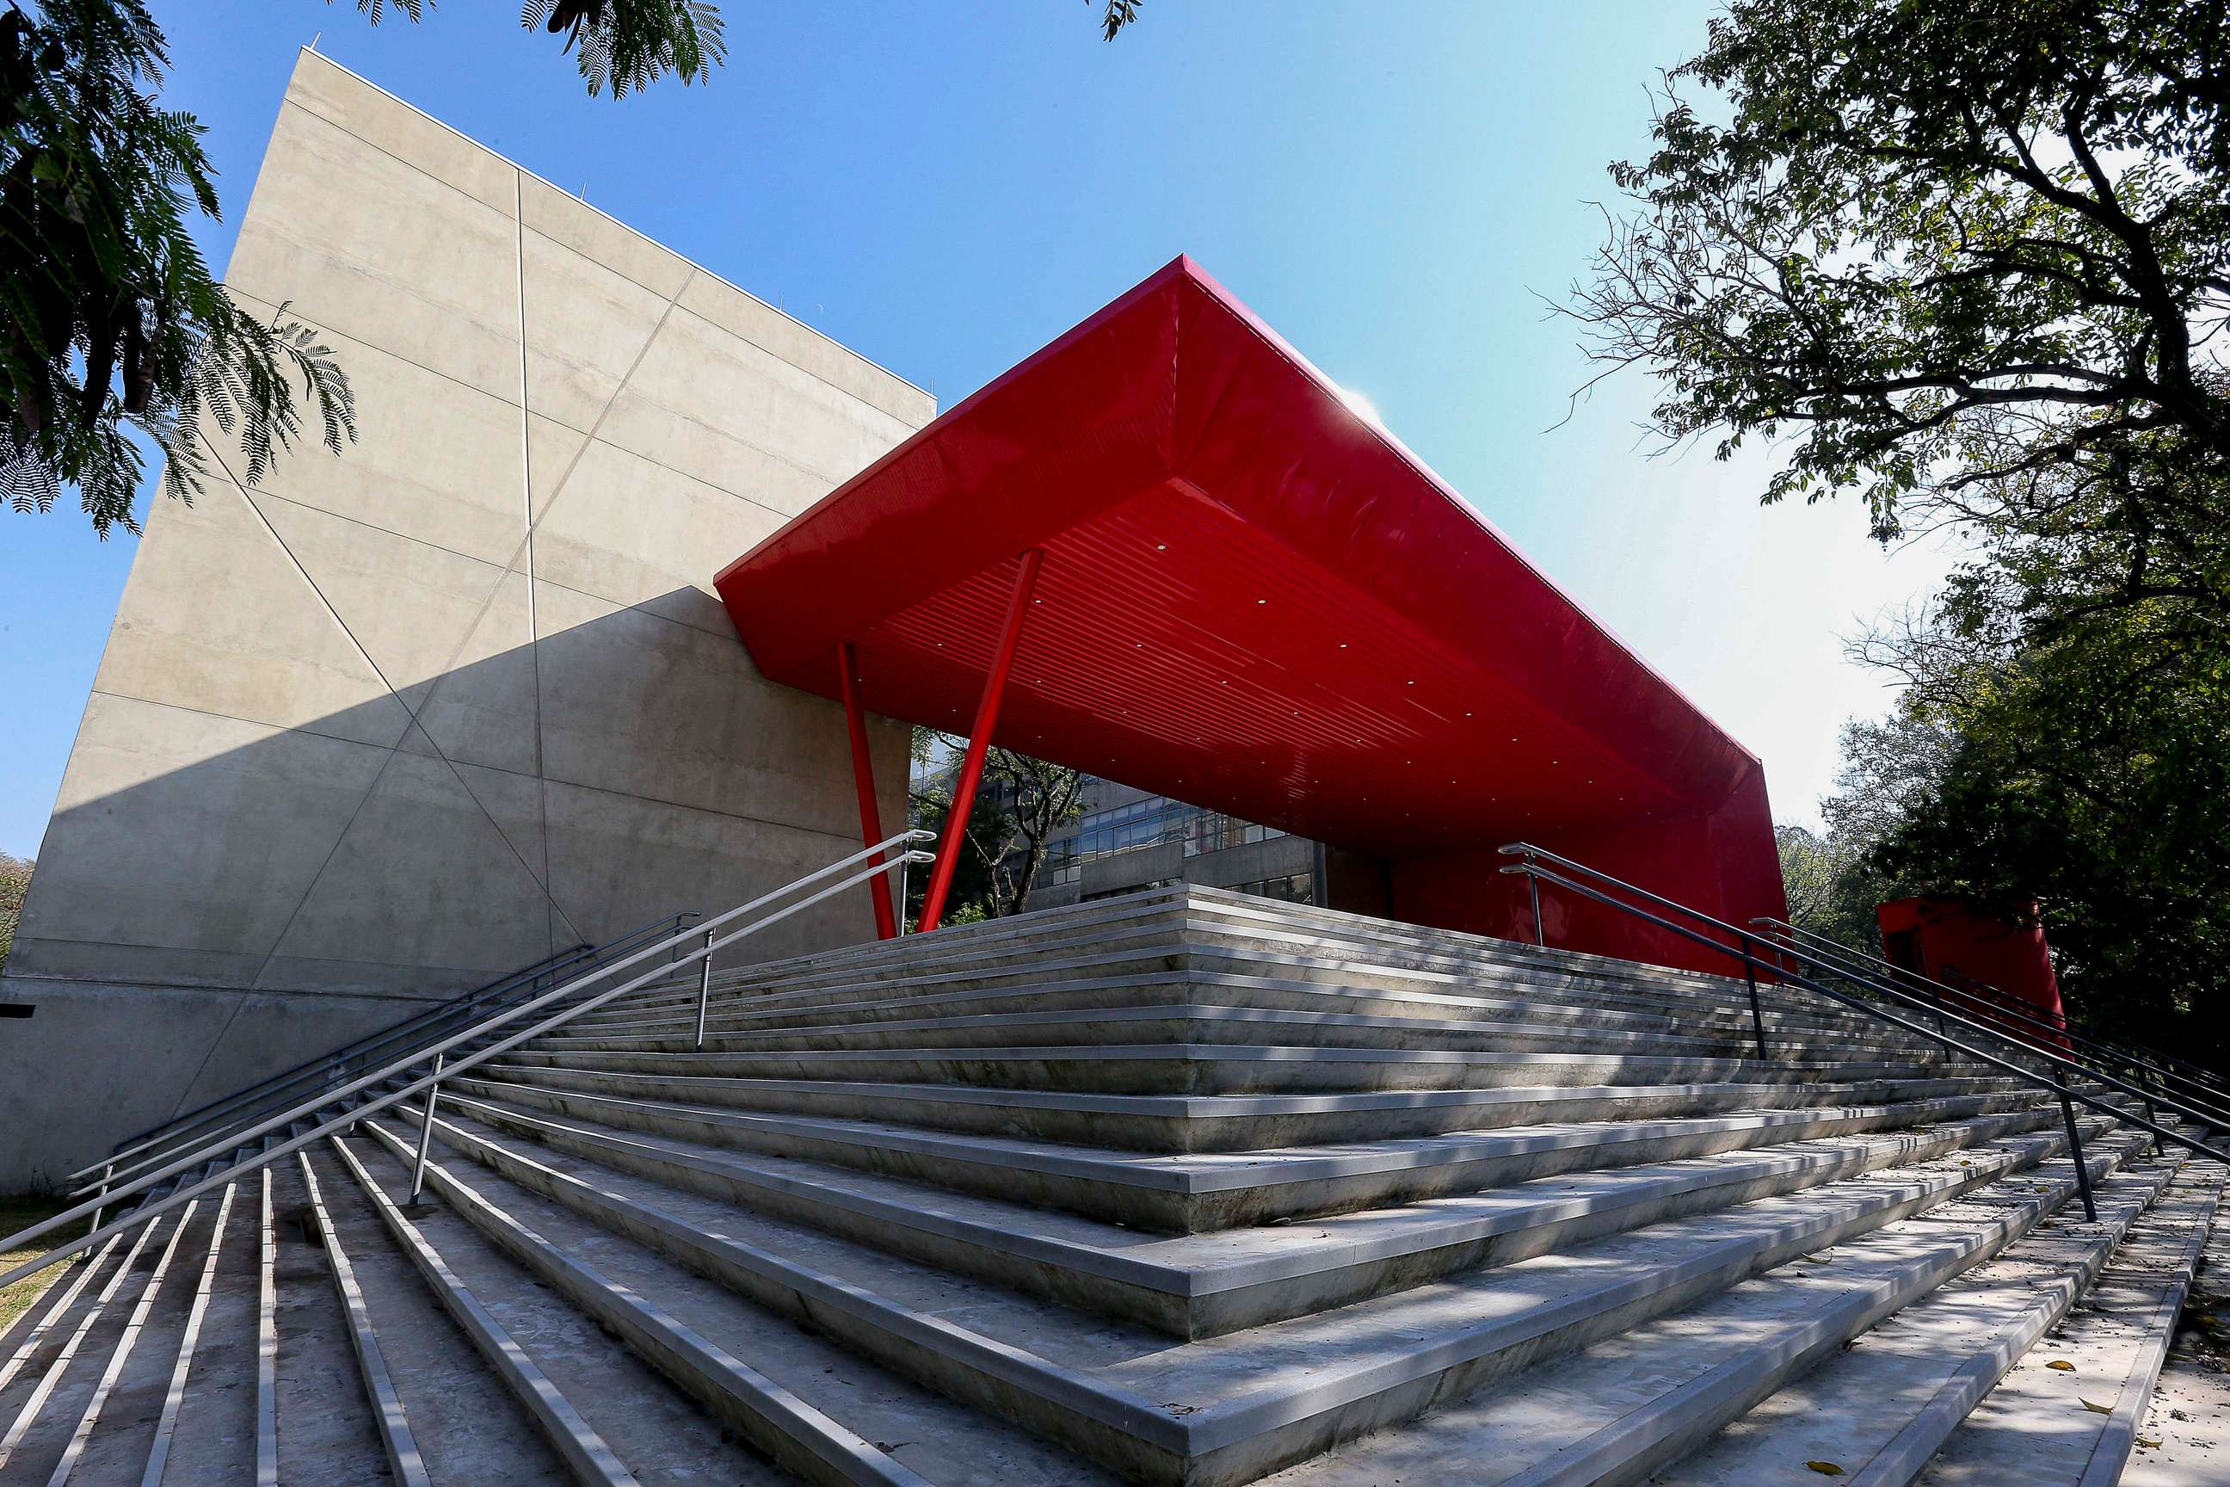
GLOBAL USP
2,700+ INTERNATIONAL STUDENTS
1,800+ ABROAD
HUNDREDS OF AGREEMENTS
JOINT & DOUBLE-DEGREES
Notes:
1.7.2013
‹#›

Slide 12
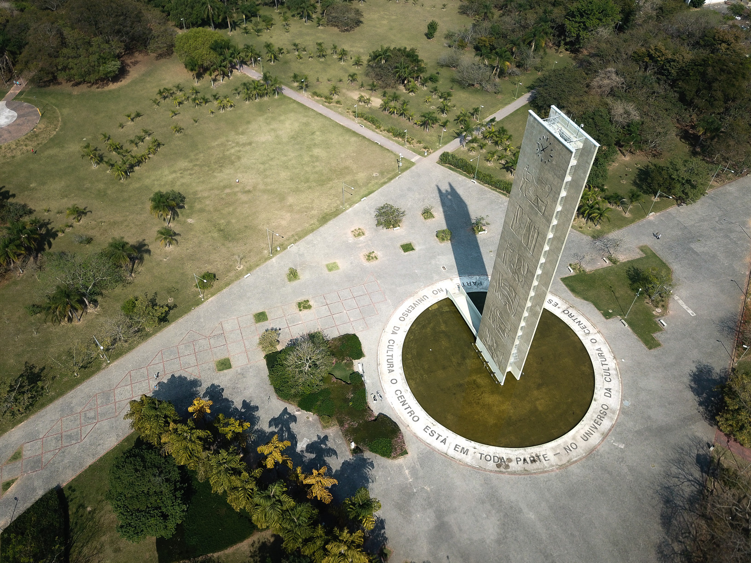
INTERNATIONAL COLLABORATION
MOBILITY
JOINT RESEARCH
STRATEGIC PARTNERSHIPS
VISITING PROFESSORS
Notes:
1.7.2013
‹#›

Slide 13
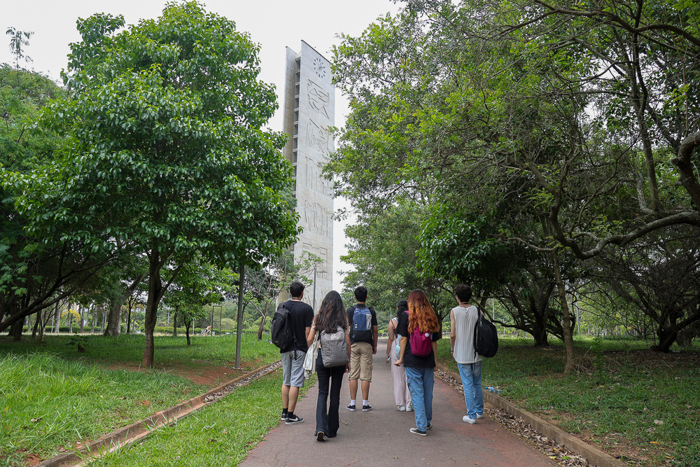
A GLOBAL UNIVERSITY
usp.br
internationaloffice.usp.br

